Slide 1
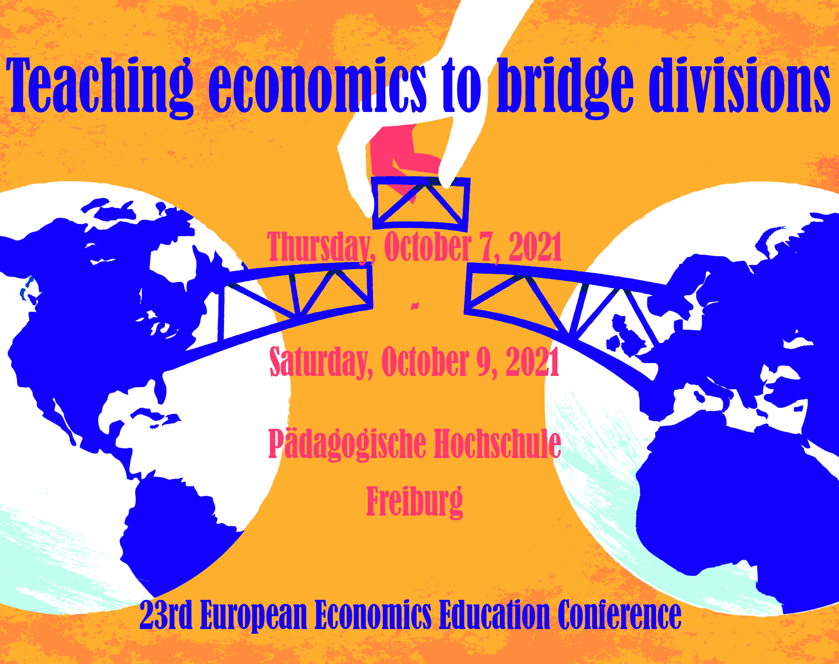


The AEEE Conference 2021
Ergodicity in economics: experimental learning activities for introductory (?) finance and economics students
Tomasz Kopczewski
Tomasz Potocki

Slide 2

Please connect with the Internet
we will have two small
Ad-Hoc experiments
You can use smartfons, laptops or tablets
Do not use IE
A QR code reader will help but is not necessary :)

Slide 3
Motivation - why ergodicity
Why do we want to teach such a complex concept from physical statistics in the economic courses - especially introductory courses?
The answer is an incomplete story of the risk and uncertainty that we taught in Microeconomics (me) and Finance (my colleague) courses. This incompleteness was bothering us a lot.
What is this story?

Slide 4
Story of the risk and uncertainty
For me, the simplest way to teach microeconomics is to find the story which is behind the equations in economic textbooks (it is the same story for beginners and for advanced students but for advanced students we use more sophisticated language - mathematics)
When we teach about risk and uncertainty we talk about a story: that we are living in the TV series "Let's Make a Deal". You know the series from Monty Hall problem but the explanation power of "Let's Make a Deal" is much wider. This TV series is a metaphor of standard risk theory.

Slide 5
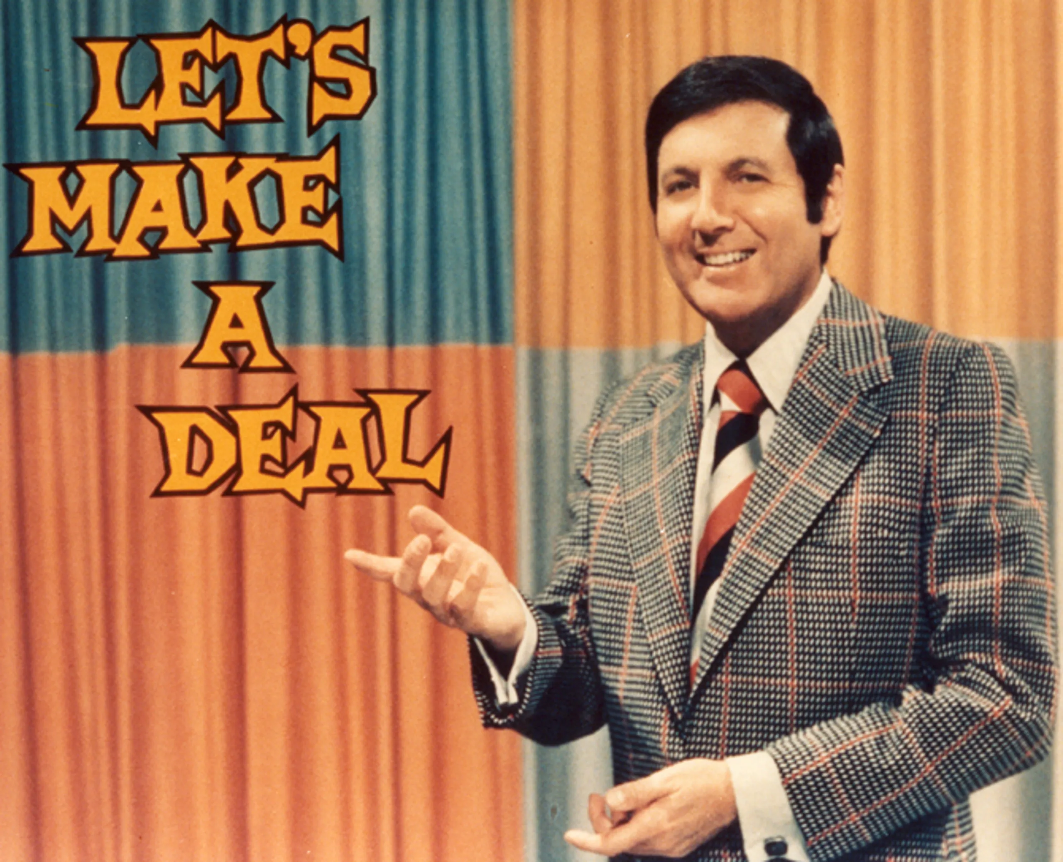
Risk - similaries to TV show Let’s Make a Deal
We have to choose between three doors –> we know the probabilities. We guess the values of hidden prizes: one small prize, one big prize and sometime can win nothing). Our knowledge is based on the previous episodes – Bayes inference). Sometimes the host offers us to give up the play and we can obtain sure compensation. The host is like a financial or insurance institution – he offers us a risk-free alternative.
$ 0
1/3
S
1
$ 900
G
1/3
$ 1000
1/3
$ 11 000
In more sophisticated theories we know distribution - a function that describes the likelihood of obtaining the possible values of a random variable. But the story is the same -> We know the distribution from historical data.

Slide 6
Risk , uncertainty, randomness
According to Knight and Keynes, we should distinguish:
risk, which refers to a situation we can be insured against, and risk means we can define an array of outcomes with probabilities attached (Let’s Make a Deal schema)
uncertainty that cannot be insured against, we do not know outcomes or/and probabilities
But in microeconomic textbooks, we do not distinguish them. We focus on risk. We added this distinction to our teaching. Even more, we present cognitive biases and use our guru Gerd Gigerenzer approach to teach about risk and uncertainty, but still, something was missing in our story ……
What was missing ???

Slide 7
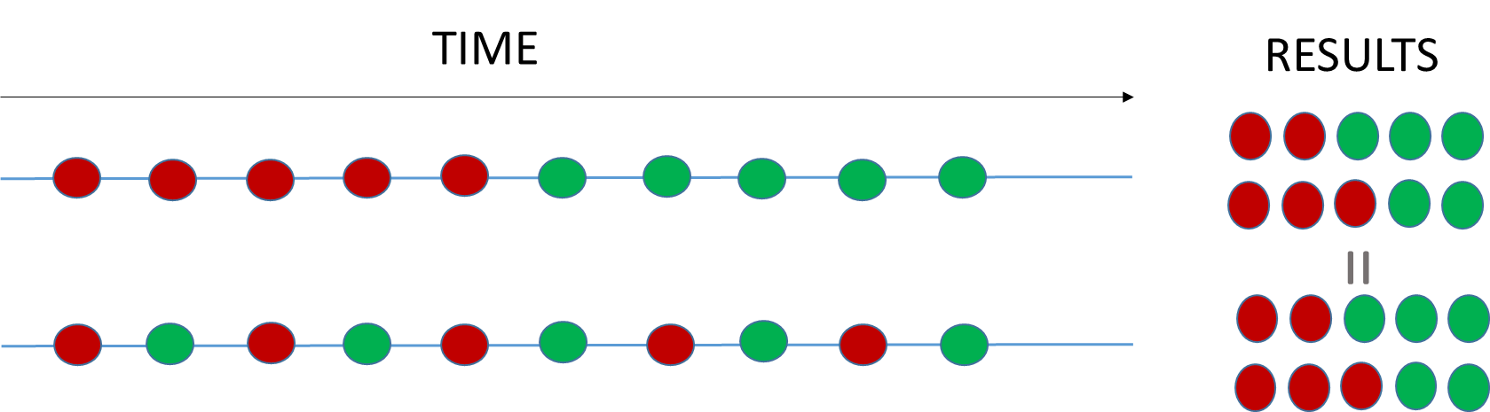
Time and path dependence
In economics, we assume that the sequence of events does not matter. The economic system is determined, and we forget that the time path matters. Suppose the red dots are periods of starvation and the green dots are periods of prosperity. In most economics models, the sequence of appearance of these periods does not matter. And these two examples are equivalent. Based on our story about the risk, we can conclude that the probability of starvation and prosperity is the same and equal ½. There is no path dependence or we do not care.
But in real life this path dependence realy matters.

Slide 8
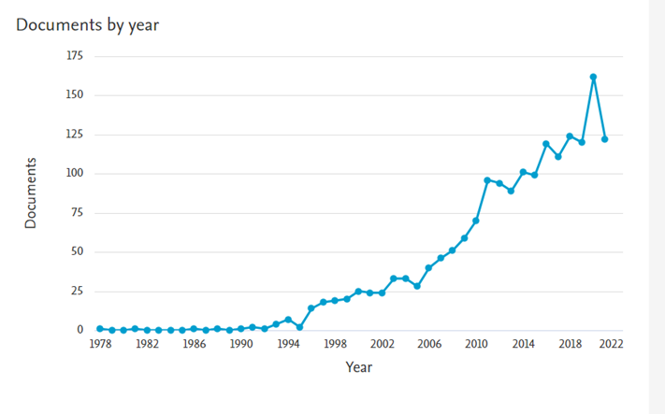
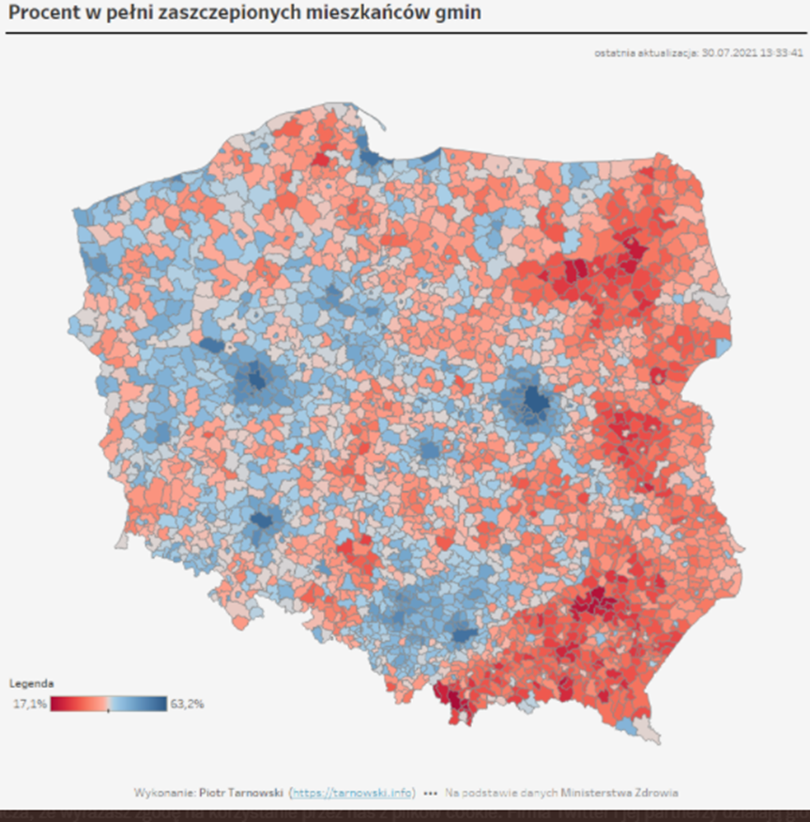
Time and path dependence
Explaining why social processes are path-dependent can be found everywhere: empirical research, art, life/philosophical parables, etc
Scopus search „path dependence” is path dependent ☺
Green innovation: The more firm have innovated in eco-innovation in the past, the more it continues to innovate in that innovation today (and vice versa). (Aghion, Dechezleprêtre, Hémous, Martin, Van Reenen, 2016).
Institutions and Wealth: In places where Europeans faced high mortality rates, they were more likely to set up worse institutions which translated lower income per capita till recent times. (Acemoglu, Johnson, Robinson, 2001)
Opposition to Covid-19 vaccinations in Poland reflects the historical division of Poland (A and B)
https://twitter.com/PiotrekT/status/1421073462727217162/photo/1

Slide 9
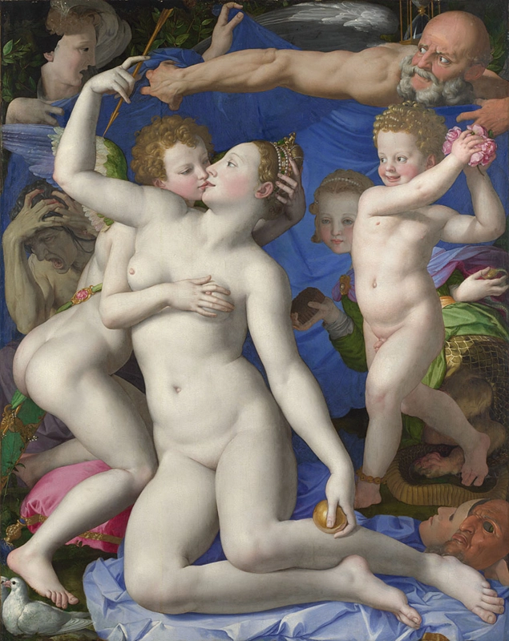
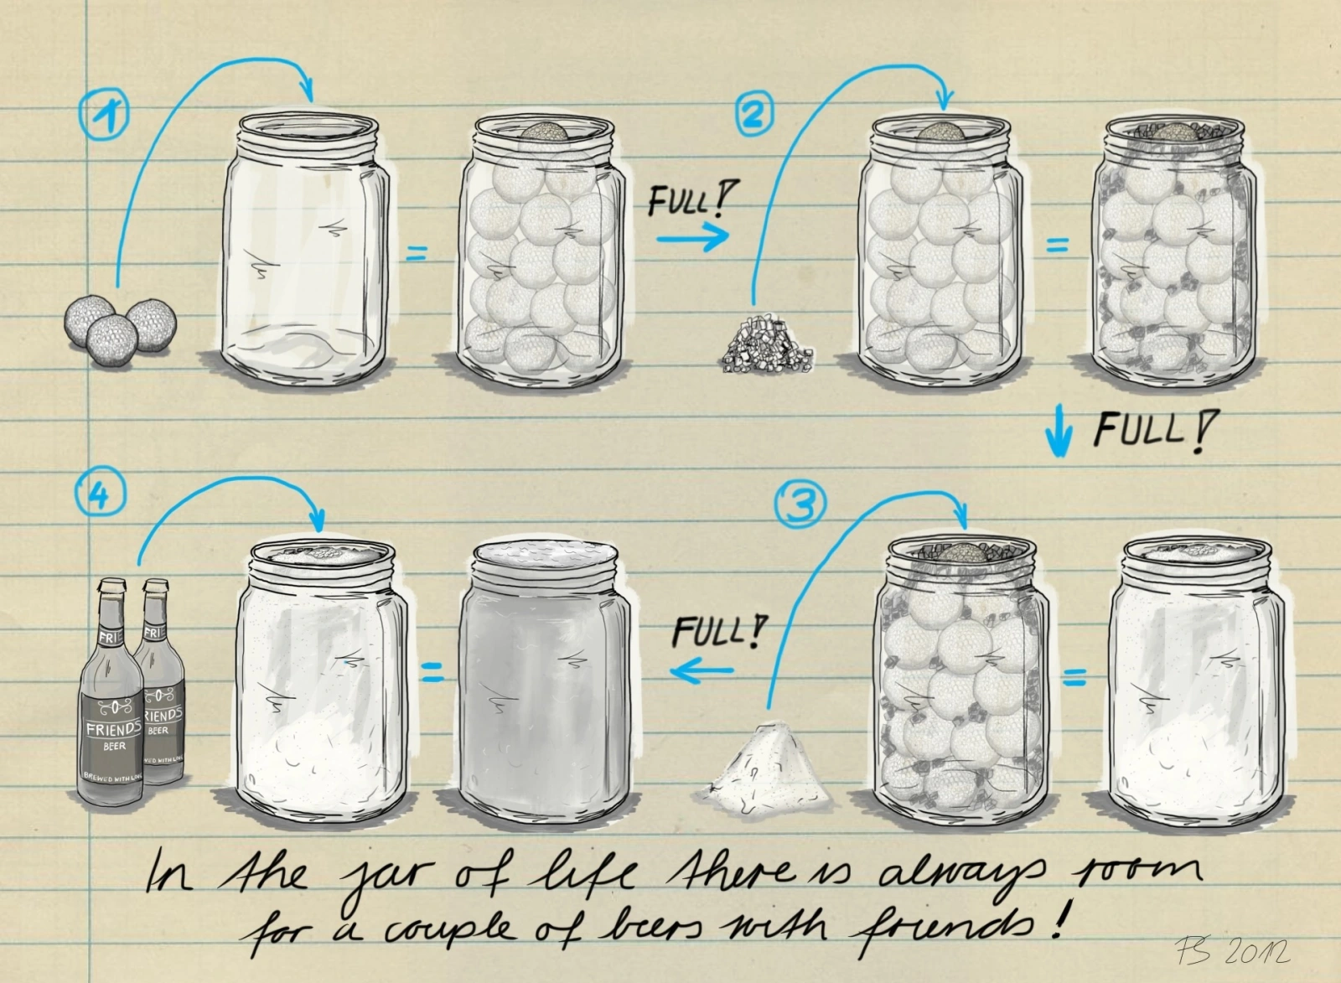

Time and path dependence
Nothing Twice
Wislawa Szymborska - 1923-2012
Nothing can ever happen twice.
In consequence, the sorry fact is
that we arrive here improvised
and leave without the chance to practice.
Even if there is no one dumber,
if you're the planet's biggest dunce,
you can't repeat the class in summer:
this course is only offered once.
No day copies yesterday,
no two nights will teach what bliss is
in precisely the same way,
with precisely the same kisses.
One day, perhaps some idle tongue
mentions your name by accident:
I feel as if a rose were flung
into the room, all hue and scent.
The next day, though you're here with me,
I can't help looking at the clock:
A rose? A rose? What could that be?
Is it a flower or a rock?
Why do we treat the fleeting day
with so much needless fear and sorrow?
It's in its nature not to stay:
Today is always gone tomorrow.
With smiles and kisses, we prefer
to seek accord beneath our star,
although we're different (we concur)
just as two drops of water are.
In poem Nothing Twice by Wisława Szymborska
In life parables such as "Jar of Life - Rocks, Pebbles, and Sand„ Put important things first!
https://balancedaction.me/2012/10/17/the-jar-of-life-first-things-first/
In film Blind Chance by Krzysztof Kieślowski
In painting Allegory of Venus and Time by Agniolo Bronzino
National Gallery, London

Slide 10
Path dependence – non-ergodic world
Path dependence is everywhere ... but not in teaching economics. Why? - we have no theoretical tools to deal with the problem. In ortodox economics we freeze time ( Robinson). But now such a tool has appeared. The missing concept of our story is to distinguish between ergodicity and non-ergodicity. We've been teaching a theoreies based on hidden ergodic assumption and the social systems are non – ergodic one. It can supplement our incomplete storytelling about risk and uncertainty, but how include it in teaching?

Slide 11
Path dependence – non-ergodic world
The ergodicity concept is not trivial and first of all, it is difficult to convince ourselves of something which is not intuitive and raises our cognitive dissonance. How to use the concept of parallel worlds during an introductory lecture?
When you assume the economic processes to be ergodic, ensemble and time averages are identical. Let me give an example: Assume we have a market with an asset priced at 100 €. Then imagine the price first goes up by 50% and then later falls by 50%. The ensemble average for this asset would be 100 €- because we here envision two parallel universes (markets) where the asset-price falls in one universe (market) with 50% to 50 €, and in another universe (market) it goes up with 50% to 150 €, giving an average of 100 € ((150+50)/2). The time average for this asset would be 75 € – because we here envision one universe (market) where the asset-price first rises by 50% to 150 €, and then falls by 50% to 75 € (0.5*150).
From the ensemble perspective nothing really, on average, happens. From the time perspective lots of things really, on average, happen. Assuming ergodicity there would have been no difference at all.
https://larspsyll.wordpress.com/2013/08/19/keynes-and-knight-on-uncertainty-whats-the-difference/

Slide 12
Time and path dependence
Our challange is to incorporate the idea to teaching and to our minds. The better way to do it is to experiment with it.
And now, you have to experience with the ergodic and non-ergodic system before the next steps - presentation some theory and analysis of how people (your) behaviour .

Slide 13
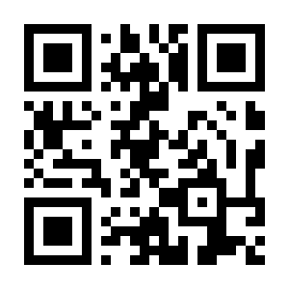
Experience the difference between ergodic and non-ergodic processes
Time to Ad-Hoc Research
You can use smartfons laptops or tablets
Do not use IE
Or use link to ease go to the page:
Labsee.com/lab/3089/ex1

Slide 14
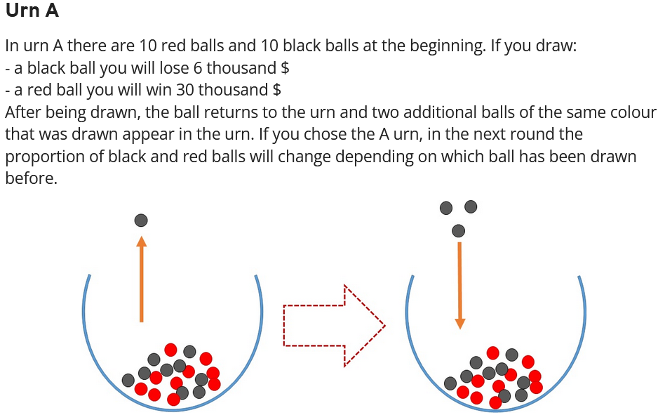
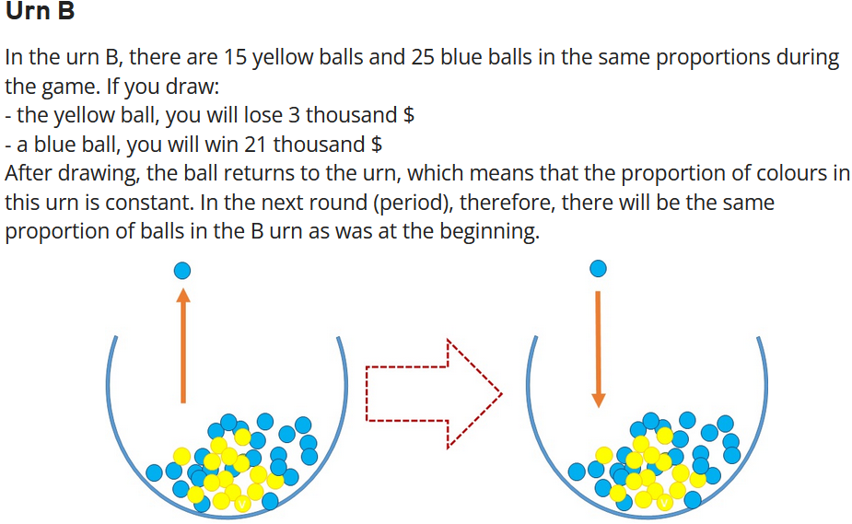
Experience the difference between ergodic and non-ergodic worlds/systems
The decision problem is straightforward. You have to decide from which of the two urns ( A or B) you will draw one ball in each of 20 rounds.

Slide 15
The difference between ergodic and non-ergodic processes
The two urns represent two processes: A is a non-ergodic one, and B is an ergodic one.
How to distinguish these processes? --> by comprising i) the ensemble average ii) the time average:
The ensemble average --> the mean of all N participants in any period t.
The time average --> the mean of all T periods for any participant n.

Slide 16
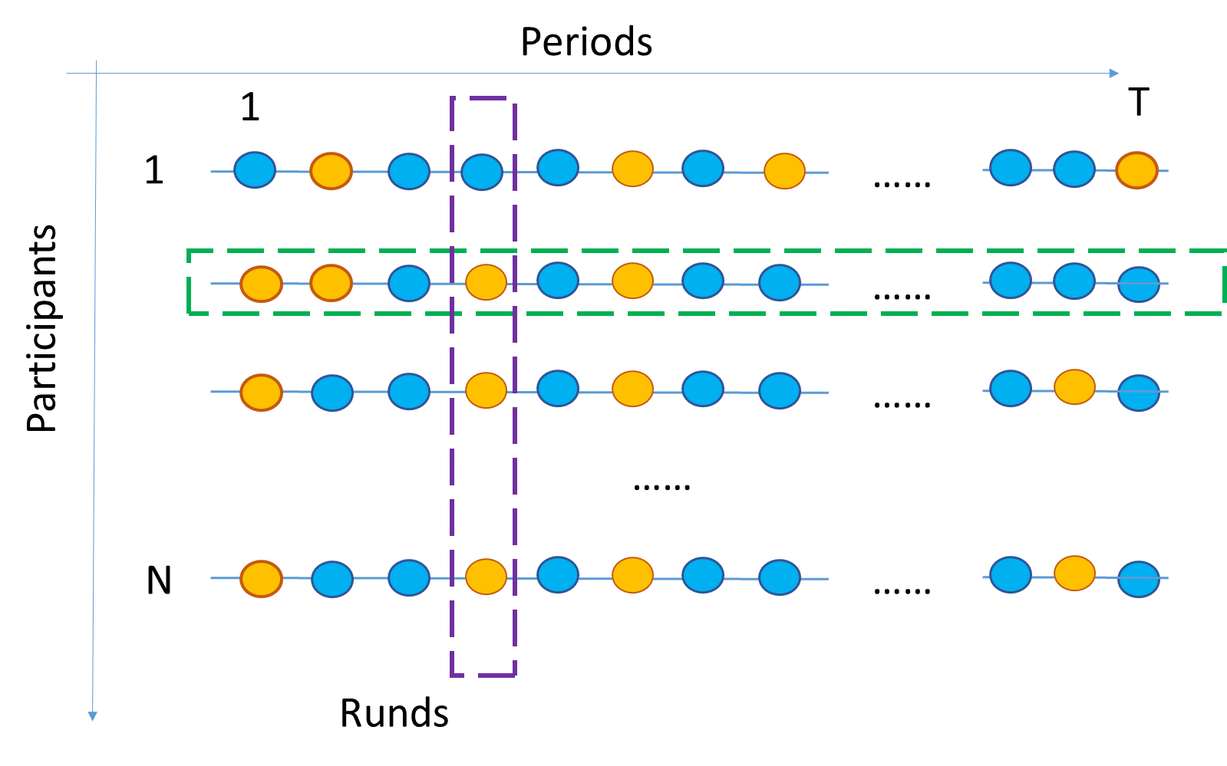
The difference between ergodic and non-ergodic processes
For large N and T (Law of Large Numbers), the ensemble average and time averages are the same for system B for each period (ensemble averages) and for each participant (time averages).
For each participant:
- the average of drawn blue balls for each period is 0.625 (25/40)
- the average of drawn yellow balls for each period is 0.375 (15/40)
--> average income of all periods for each participant = 12 [0.625*21 + 0.375*(-6)]
For each period:
- the average of drawn blue balls for each participant is 0.625 (25/40)
- the average of drawn yellow balls for each participant is 0.375 (15/40)
--> Average income of all participants for each period = 12 [0.625*21 + 0.375*(-6)]

Slide 17
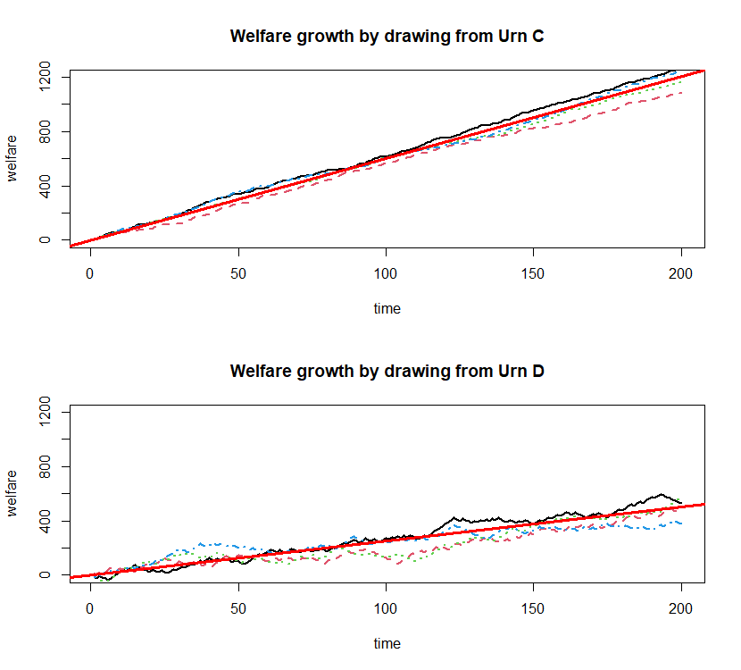
The ergodic process
The time and ensemble averages equality (ergodicity) give us easy criteria to compare lotteries (drawing from urns). When we have two processes of B type (drawing from urn C or D for 200 times) we know that the best choice is for all participants in any period of time to choose C (mean-variance criterion - if we assume the person is risk-averse). The red lines show us the average cumulative welfare for subjects for T=200. Choosing C gives us more welfare and lower deviations from the average.
$ 10
1/2
C
1/2
$ 2
$ 15
1/2
D
1/2
$ - 10

Slide 18
The story about ergodic world
If our salaries, stock market earnings, and other economic events are ergodic processes, then we are living in a very idyllic story about the world. If you are rational and choose the proper "urn", sometimes you are above average, sometimes below. Even if there is a high risk, sooner or later, our fate disappeared, and it will be fine. There is no path dependence. Society is egalitarian in long run.
Unless you are not able to choose well - you are not rational, you make cognitive biases and do not learn - you are poor, but it is your and only your fault.

Slide 19
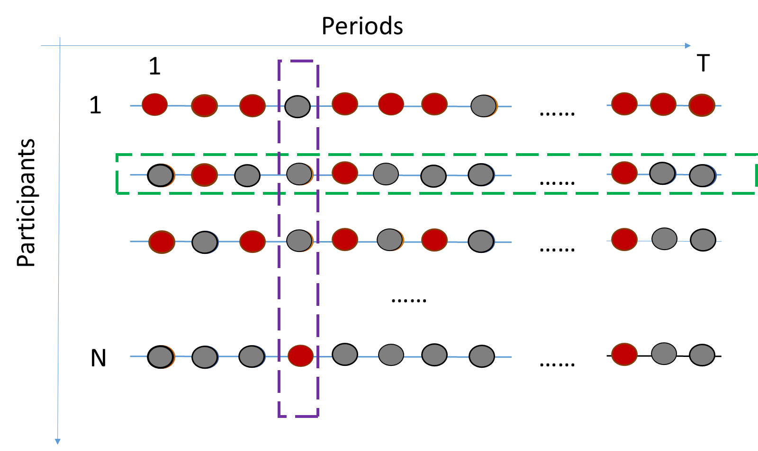
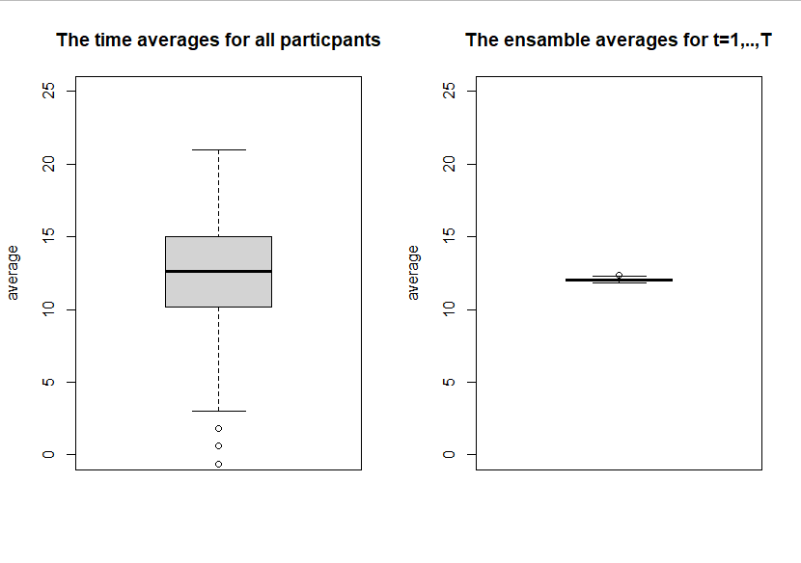
The non-ergodic proces
The ensemble average and time averages are not the same for process A.
For each participant, the time average of drawing red and black balls depends on the realization of the process there is path dependence.
For our case, average income of all participants for each period tend to be the same for large N

Slide 20
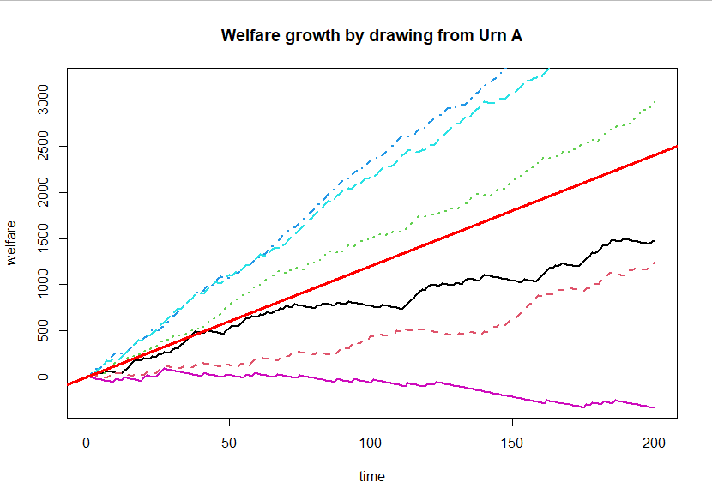
The ergodic and non-ergodic proces
Ergodic processes better describe the world. Regardless of our abilities, we can both be super-rich and become extremely poor.
Our material status also is determined by the time path - the first few failures cause that we will never reach the average welfare for society. The first few successes will set our life. It is not without reason that the Polya urn (the name of the scheme of drawing form A urn) has a property expressed by the aphorism "The rich get richer and the poor get poorer".

Slide 21
The rich get richer and the poor get poorer
In the case of our experiment, everyone had the same chance of being rich or poor at the beginning. But in real life, the first event (school, study,...) is mainly determined by the status of the family. In our experiment, we can simulate this by changing the proportions of the balls at the beginning. It can be different for different people.
Let’s do Monte Carlo simulation and suppose:
  Group X (reach) starts with 10 black and 20 red balls.
  Group Y (poor) starts with 20 black and 10 red balls.

Slide 22
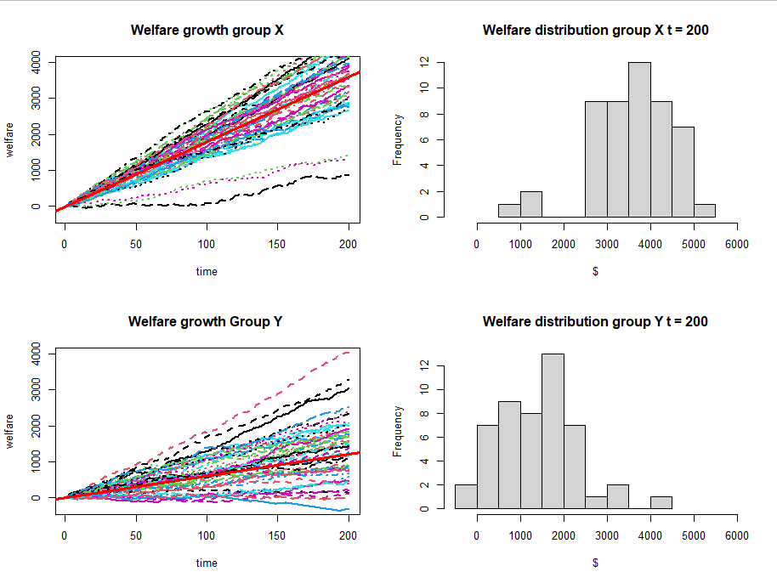

The rich get richer and the poor get poorer
A transition from one group to the other is possible, but these are rare cases. The "Rags-to-riches" myth is very popular in the media, but in real life, the path dependence is so strong.
https://www.quora.com/What-does-it-really-take-to-go-from-rags-to-riches

Slide 23
Let’s make a deal is not a valid schema for the experiment
$30
The ergodicity of the processes makes it impossible to compare lotteries as presented in the textbooks -> the is no possibility to use the „Let's make a deal schema”. In our experiment, we compare ergodic and non-ergodic processes and it makes it more challenging.
According to orthodox theory, we should choose as risk-averse persons (and this is mainly assumed ) draw from urn B. The expectation value of A and B is the same but B is less risky.
0.5
A
E = 12
0.5
- $6
$21
0.625
B
E = 12
0.375
-$2

Slide 24
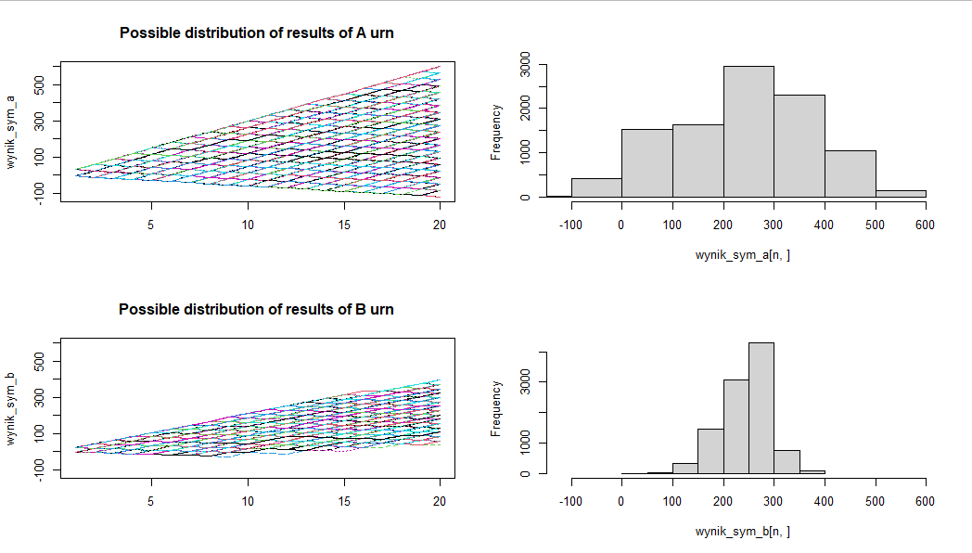
Let’s make a deal is not a valid schema for the experiment
The experiment is brand-new (I just finished programming the final version last week), and we did not find any other experimental study like this. So we have: i) no theory/intuition ii) have small data set to exactly conclude about the behaviour of students. However, based on our tiny sample, we can observe some patterns:
min = -120 max = 600 mean = 237.55
Almost all participants choose urn A in the first round. The behaviours are not explained by the textbook theory.
Typical student strategy is: for few first periods choose urn A and keep choosing it until there were significantly more losing balls than winning ones, then switch to urn B, which was a safer choice.
The MC simulation explains why: urn A can give you ern a lot of money and expected losses on two or three rounds are small compared to potential winnings after 20 rounds. Students play with path dependence.
min = 36 , max = 396 , mean = 240.06

Slide 25
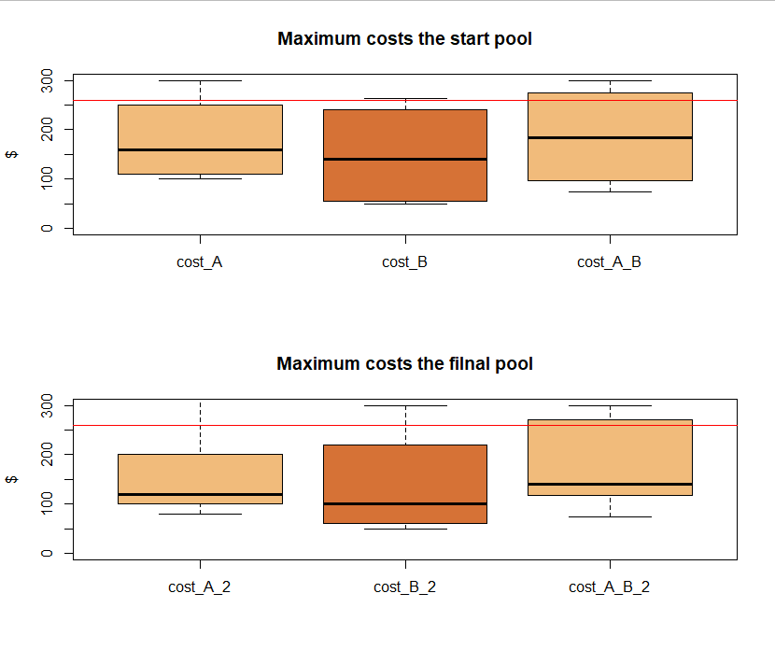
Let’s make a deal is not a valid schema for the experiment
Students would like to pay more for participating in venture A than for participating in venture B. But the valuation of the cost of entry is smaller than expected values (red line). Are they risk-averse people? It is contradicted their choices of A instead of B.
They do not value much possible to have a safe alternative B. The declared maximum cost of entry for A is greater than the maximum cost of entry for A and B together for a large part of students (irrationally behavior - more options should mean better). The comparison of the start and final questions shows that the experience changes their attitude.
They do not use and cannot calculate the expected values for urn B. It is a shocking result. I tested the experiment on candidates for two fields of study: Data Science and Quantitative Finance.

Slide 26
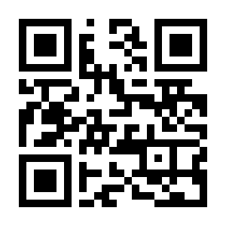
Ad-Hoc Research
How to applied ergodicity to finance.
You can use smartfons laptops or tablets
Do not use IE
Or use link to ease go to the page:
Labsee.com/lab/3090/ex2

Slide 27
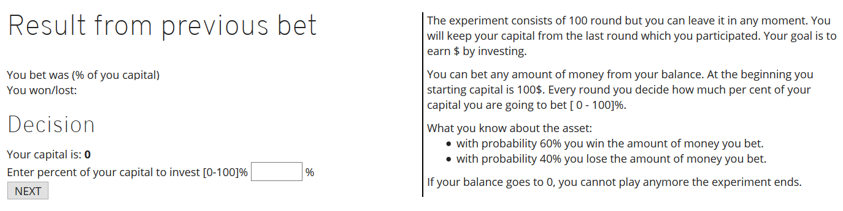
Ergodicity in finance
The experiment consists of 100 round but you can leave it in any moment. You will keep your capital from the last round which you participated. Your goal is to earn $ by investing. You can bet any amount of money from your balance. At the beginning you starting capital is 100$. Every round you decide how much per cent of your capital you are going to bet [ 0 - 100]%.
What you know about the asset:
  with probability 60% you win the amount of money you bet.
  with probability 40% you lose the amount of money you bet.
If your balance goes to 0, you cannot play anymore the experiment ends.

Slide 28
Ergodicity in finance
If we applied the schema "Let's Make a Deal", we would earn a lot of money.
$$E=100 ∗ \left(0.6∗100− 0.4∗100\right)=2000$$
The expected value of the lottery is positive - there is no possibility to lose in 100 rounds.

Slide 29
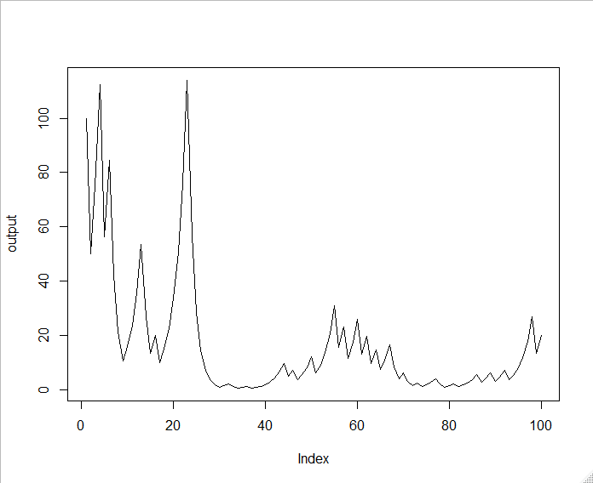
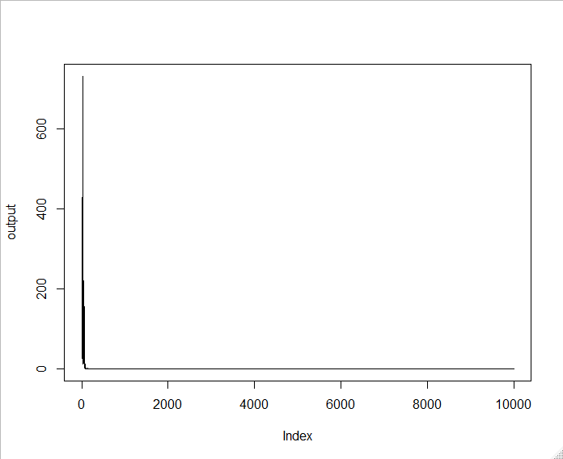
Non-ergodicity in finance
But we can observe a lot of bankruptcies because the experiment is based on a non-ergodic scheme. The sequence of a few bad events caused us to go bankrupt and leave the experiment.
If we invest 50% of our wealth in each round, we may even win a lot of money in the short term, but in the long term, we are doomed to failure. The fate can be shown by the MC simulation.
iter <- 100
iter <- 1000

Slide 30
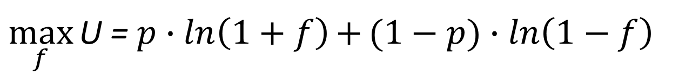
Non-ergodicity in finance – Kelly criterion
Kelly criterion (the simplest version) - the formula of maximizing the pay-off in iterated lotteries.
  f * is the fraction of our welfare we invest in the lottery
  p is the probability of winning;
  q is the probability of losing -> 1 − p.
We can obtain the result using the adjusted Bernoulli formula:
$$f^{∗}=p −q=p −\left(1−p\right)=2p −1=2∗0.6 −1=0.2$$
$\max_{f}{\text{U}}$ = $p∙ln\left(1+f\right)⁢+(1−p)∙ln\left(1−f\right)⁢$

Slide 31
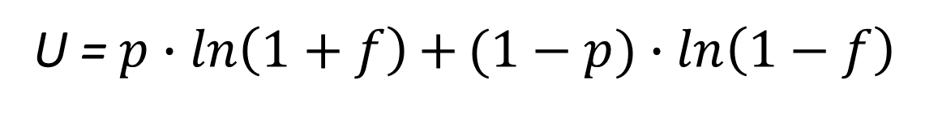
Non-ergodicity in economics – revolution
Now, the interpretation of the maximization problem is change: We maximize the expected geometric growth rate [arithmetic mean of the log of wealth]. The optimal value of f* is independent of the M – it is a percentage value of our welfare
U = $p∙ln\left(1+f\right)⁢+(1−p)∙ln\left(1−f\right)⁢$
ln(1+x) ~ x
If you want to see how Bernoulli's work can be reinterpreted, be sure to read: https://ergodicityeconomics.com/2018/02/16/the-trouble-with-bernoulli-1738/

Slide 32
Let’s make a deal is not a valid schema for the experiment
Our intention was to present i) the ergodicity ii) path dependence in economics to a wide audience. The challenge is still open. We have to simplify the concepts as much as possible. And we have to create a good story to sell it to youngsters. But it is worth do it.
Why?
For us is exciting that the idea of non-ergodicity is a realization of Keynes, Knight, Robinson, Kay’s (and many more non-ortodox economicts) approach to incorporate time and uncertainty into economics. “it is high time to abandon the mainstream and take to the turbulent waters of truly dynamic analysis” (Robinson 1978).
I am so excited because the revolution is done by mathematicians and physicists who incriminate orthodox economists of using "old" nineteenth-century mathematics. Fight fire with fire. Is it ironic? ☺

Slide 33
Stay tuned ☺
Absent Tomek was going to focus on more pedagogical issues concerning path dependence. I've focused on the new revolutionary concept of ergodicity. We are on our way to prepare pedagogical papers and materials. But firstly we will test our solution on secondary school pupils. To understand the ergodicity visite:
https://www.nature.com/articles/s41567-019-0732-0
https://www.youtube.com/channel/UCJG8N5P1RFX29JTKt_6R21A (Ergodicity TV)
https://ergodicityeconomics.com/
To apply ergodicity in your life read the philosophical storytelling: „The jar of life – Stones, pebbles and sand”
Best, Tomek&Tomek

